Slide 1
PROFILES COLLEAGUE FETCHER
SCOTT MURPHREE. VICTORIA MAIN. LINDSAY BURTNER.

Slide 2
The Problem
Connections Profiles is a new social application for efficient professional networking
Users already use other networks
The process of looking up colleagues on Profiles can be slow
  Search, view profile, Add as Colleague, include message, invite, repeat. (4 pages)

Slide 3
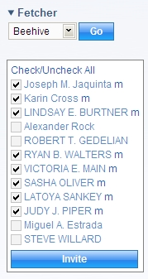
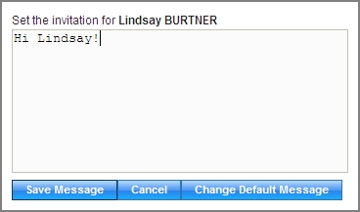
The Solution
Profiles Colleague Fetcher (sidebar widget)

Slide 4
Features
Fetch friends from many different networks
  Beehive
  Fringe
  LinkedIn
  Facebook
All on one page, one search per network
Customizable invitation messages
  Set default and/or individual messages

Slide 5
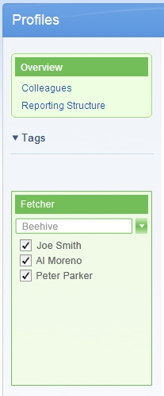
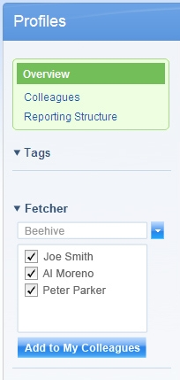
Design Ideas
As simple as possible

Slide 6
Technical Issues
The Profiles API is rather lacking
  The documentation is outdated (improving)
  Not documented
    Inviting colleagues (will be in new version)
    Getting accepted colleagues (in new version)
  Not apparently implemented
    Determining if a colleague has already been invited
      Might be in new version
  Difficult to get information on the authenticated user (fixed in new version)

Slide 7
Technical Issues
Cross-Domain Requests
  Getting friend-lists from other networks requires cross-domain requests
  A solution is a proxy on Profiles
    Should be in new version
  For development, using some Firefox hacks
    UniversalBrowserRead
    codebase_principal_support

Slide 8
Demo

